Slide 1
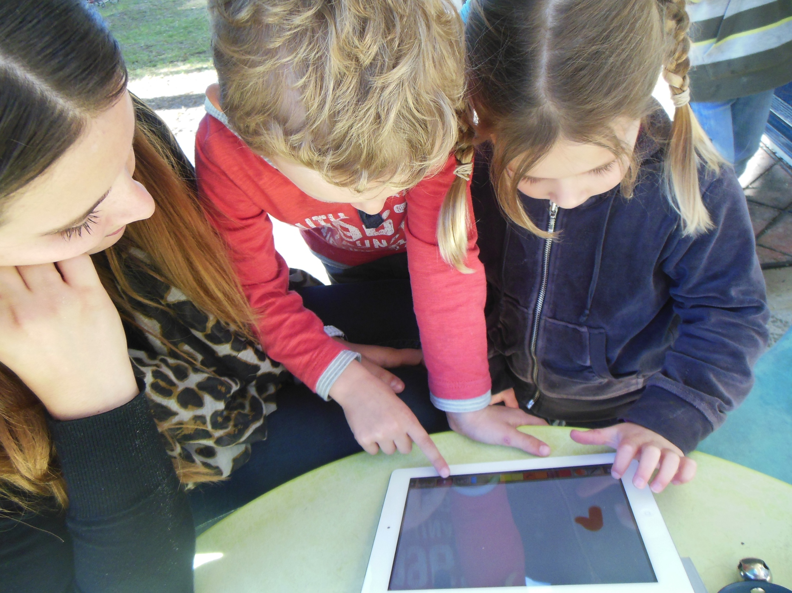
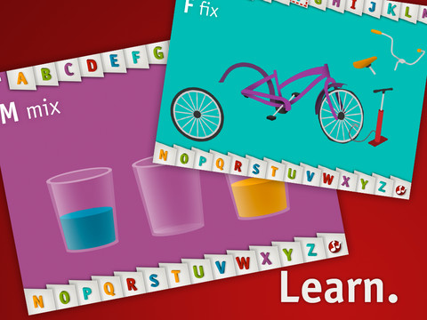
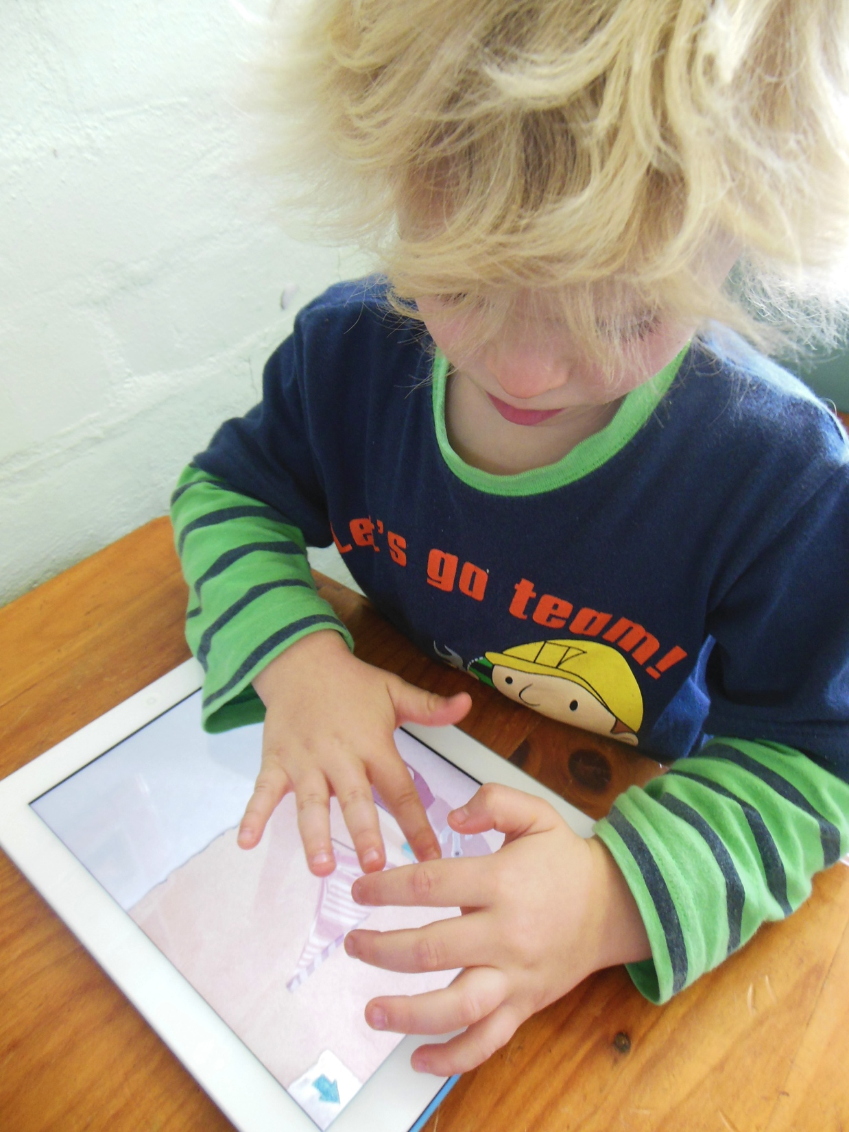
iPossibilities in the early years.
Professor Nicola Yelland
College of Education
Victoria University.

Slide 2
iPads in the early years…
Describe what constitutes effective pedagogies when using tablet technologies in early childhood settings.
Explore the potential of applications to support the teaching and learning of literacy and numeracy with young children.
Examine the ways in which tablet technologies can be incorporated and integrated into early childhood curricula to support new forms of meaning making, knowledge building and learning in the early childhood years.
Work with teachers to explore professional learning opportunities that will enable teachers to effectively incorporate tablet technologies into their programs.
Consider resources for teachers to illustrate practical ways of using tablet technologies with young children.

Slide 3
What we found…
Teachers can incorporate new technologies into their pedagogical repertoire when they are scaffolded and utilize appropriate conceptual frameworks for understanding teaching and learning with new technologies (e.g. the SAMR model, Puentendra, 2011).
The use of specific applications on tablet technologies (e.g. iPads) enable young children to have multimodal experiences that have the potential to extend learning outcomes. These applications can be incorporated in play based kindergarten learning programs to enhance learning alongside traditional materials and extend the children’s learning potential via investigations and reflections. In the first year of school the tablets can both support and extend literacy and numeracy learning when they are integrated into the program.

Slide 4
The use of tablets is influenced by the teachers’ philosophy, their preferences for learning and their stated goals for the children in their class. In primary school contexts, their usage was also impacted by state mandated curriculum and outcomes. The quality of children’s learning is influenced by a range of factors. Tablets can also be used to support and extend learning in early childhood centres and schools, but their use is highly related to the teacher’s confidence about using them and the ways in which they are perceived to add value to the learning experiences. The most innovative uses of tablets were when they were used for investigations by children who were able to create electronic artifacts that both communicated their discoveries, and enabled them to reflect on their learning in new and dynamic ways.

Slide 5
Teachers recognized the need for leadership and information about how to effectively use tablets in their learning programs. They also stated that access was still a pervading issue that inhibits their more frequent use. The teachers suggested that professional learning opportunities needed to show practical ways to use tablets in literacy, numeracy and in investigations which now form the basis of their programs.

Slide 6
Planning formats and requirements vary according to the age of the children and the requirements that the centre, or school, place on their teachers.
Kindergarten - was spontaneous and written in retrospect, in the form of observations that then formed the basis for future interactions with the children.
In the primary school context – teachers planned collaboratively and were able to embed the use of school iPads into their literacy and numeracy ‘rotations’.

Slide 7
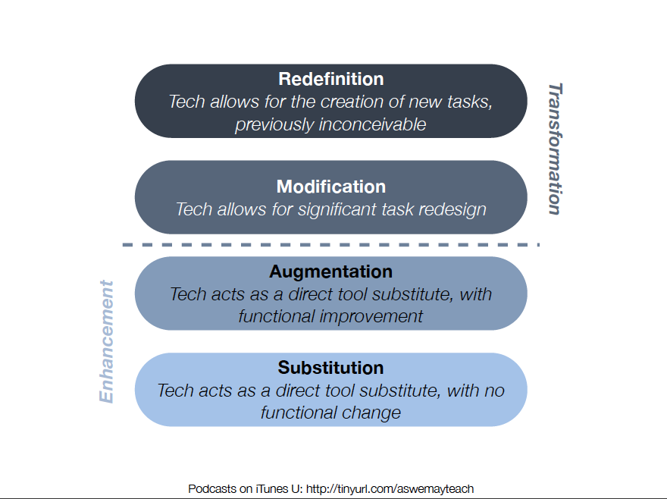

Slide 8
Substitution – in which the technology acts as a substitute for traditional teaching materials and thus there is no fundamental change to the learning context, apart from the fact it is digital.
Augmentation – the technology being used changes the learning context with some functional improvements being made.
Modification – where the technology allows for some significant task redesign.
Redefinition – in which the use of technologies allows for the design of new learning experiences that were previously not possible.

Slide 9
4 year old kindergarten
Using the (digital) camera for explorations and reflection.
Searching for information for investigations and to support play based scenarios.
Creating eBooks.

Slide 10
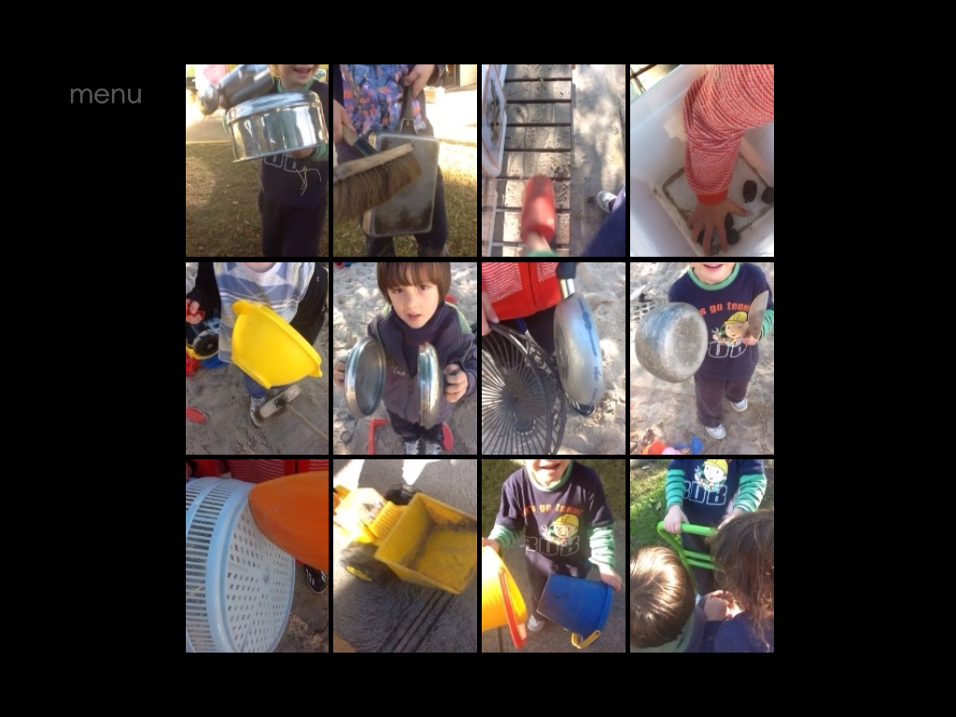

Slide 11
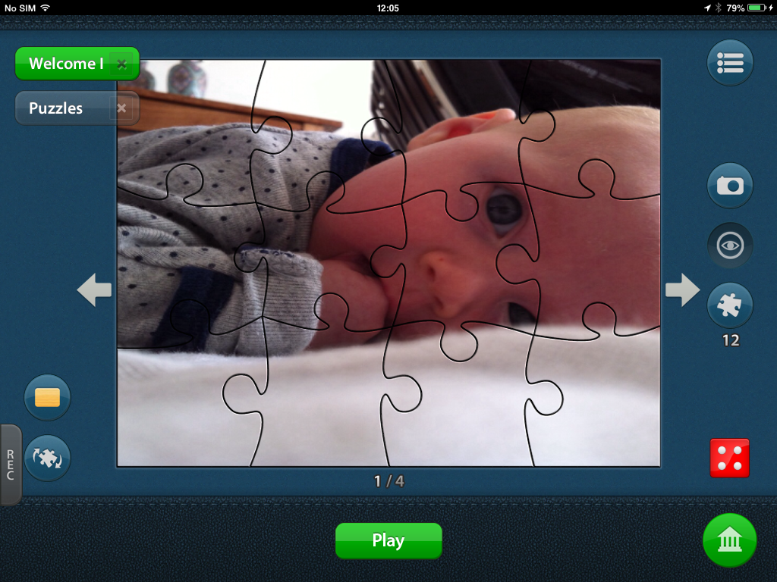

Slide 12
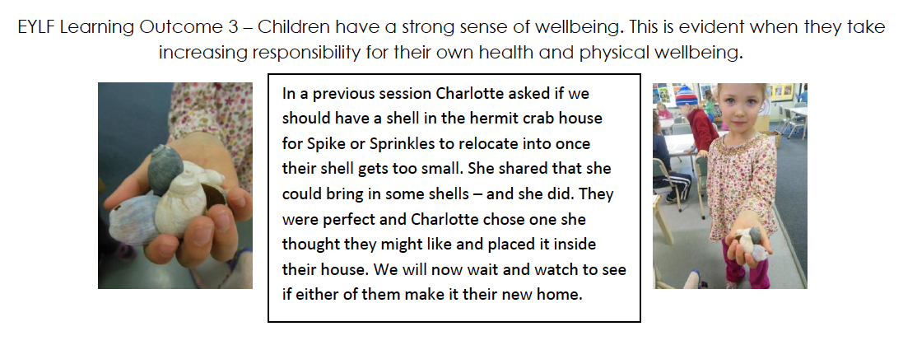

Slide 14


Slide 15
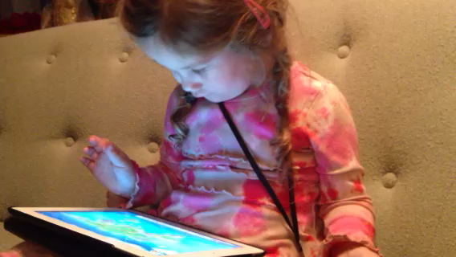
Sophia (Age 2 years) goes to Egypt.

Slide 16
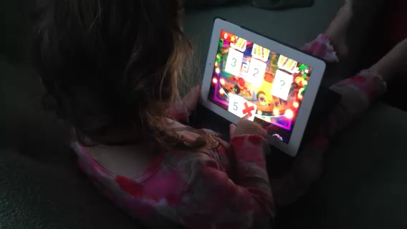
The lady says the right number

Slide 17
Preparatory class (5 / 6 year olds)
The teachers indicated that the following activities were needed:
Support for number Recognition and sequencing to 10
Extension numeracy (number stories as eBooks and electronic number sets and creating graphs).

Slide 19
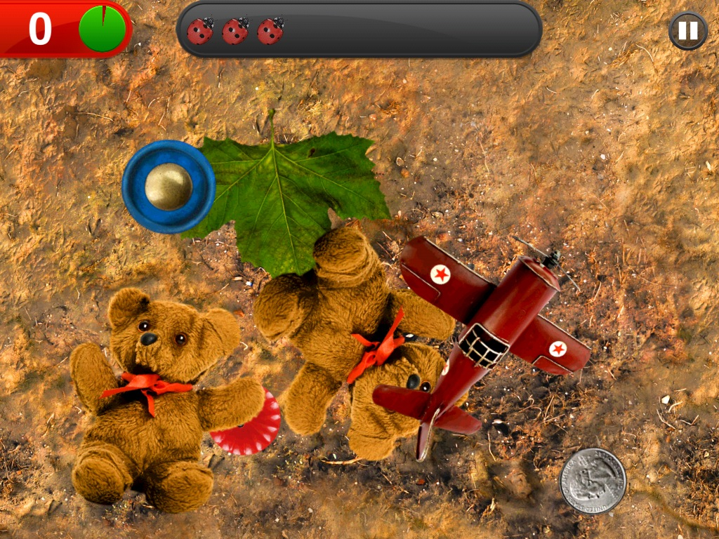

Slide 21
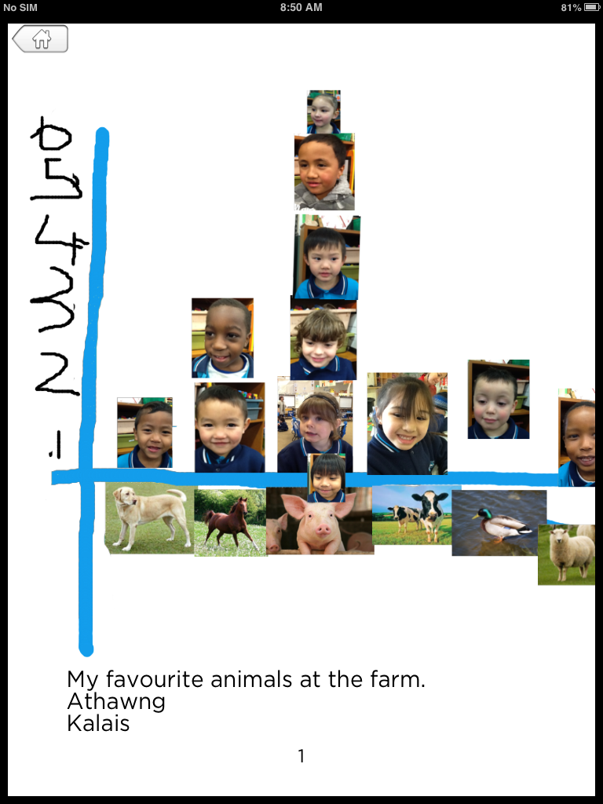

Slide 22
Lulu aged 3 years
Ansel and Clair go to Africa
http://www.youtube.com/watch?v=-fbfILtlFQc
In this vignette Lulu turns on the tablet and selects a game called Ansel and Clair. The activity takes her to Africa where she finds out about the soft shell turtle and crocodiles. There is not much to do in the game except to navigate to the different parts where the action occurs (visual mode) and information is provided (aural). Finally, she takes a photo with the onscreen camera and places it in a travel book that is being compiled.

Slide 23
Toca Boca (music maker)
http://www.youtube.com/watch?v=d6U0w6NZoMI
This game can encourage exploration of basic musical skills with pitch and sound variations.

Slide 24
Organizational aspects
BYOD iPad programmes?
Teacher aides/ educational assistants
Parent volunteers
Peer experts – tablet tutors
Does the brand matter? – its all about new learning!
Let go….. Enjoy, play and learn!

